Slide 1

ACOLYTE – THE BUDGET HELPER
PILLAI COLLEGE OF ENGINEERING (NEW PANVEL)
Department of Electronics & Computer Science
Group members
28_Piyush Chaudhari
33_Raj Gatle
40_Sumit Jadhav
43_Shreyash Yadav
Under the guidance: Prof. Rubina Shaikh

Slide 2
INTRODUCTION
Tracking daily expense is not so innovative.
Many traditional and technological approach is found to track our expenses and budget with their own functionality.
From decades ago and today we have been writing our expenditure in a register to calculate the profit or saving. Not only this many desktop and mobile applications has been developed for this purpose.
Expense tracker is a refined system which allows user to efficiently manage hischer expenses with ease.
Tracking expenses daily can really help to us save lot of money.
Once we start off by trucking our expenses each day, we will be able to get a better idea where you are spending your money, so you stay in control and achieve your goal.
It will be able to generate your expense and saving report as time duration you selected. There will be a reminder that will help to save money for your pre-defined expenses.
A

Slide 3
MOTIVATION
Manage records of user expenses , Provide detailed Report within required time period.
Tracking the regular expenses information.
Reduce The Manual Work.

Slide 4
PROBLEM STATEMENT
At the end of the month we start to have money crisis.
Lack of proper planning of our income.
Person has to keep a log in a diary.
All the calculations needs to be done by the user.
Overload to rely on the daily entry of the expenditure.
A

Slide 5
OBJECTIVE
To know where the money is going.
To spend only on priorities.
To save money for pre-defined expenses.
To plan on your future investments
A

Slide 6
EXISTING SYSTEM
In existing, we need to maintain the Excel sheets, CSV etc.
Files for the user daily and monthly expenses.
In existing, there is no as such complete solution to keep a track of its daily expenditure easily.
To do so a person as to keep a log in a diary or in a computer, also all the calculations needs to be done by the user which may sometimes results in errors leading to losses.
A

Slide 7
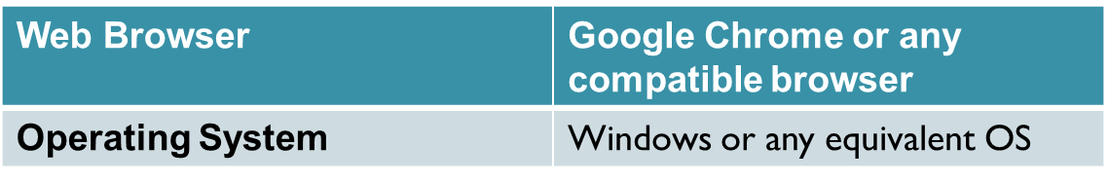
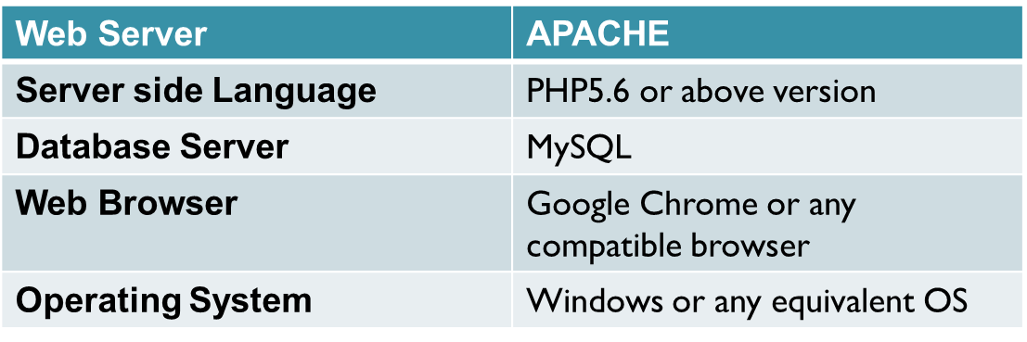
REQUIREMENT SPECIFICAION
Software Requirement:
Client Side
Server Side

Slide 8
ARCHITECTURE
In Acolyte the budget helper we use PHP and MySQL database. This is the project which keeps records of daily expenses. Acolyte has two module i.e.
User
Admin

Slide 9
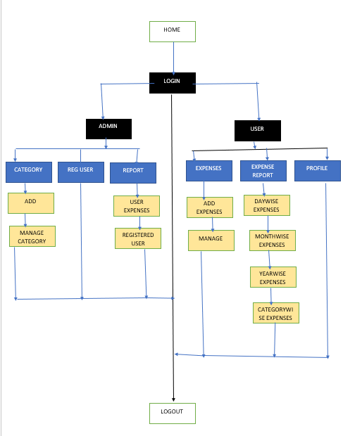
ARCHITECTURE DIAGRAM

Slide 10

PROCESS DESIGN
Back End:
HTML
Enter
SQL
CSS

Slide 11
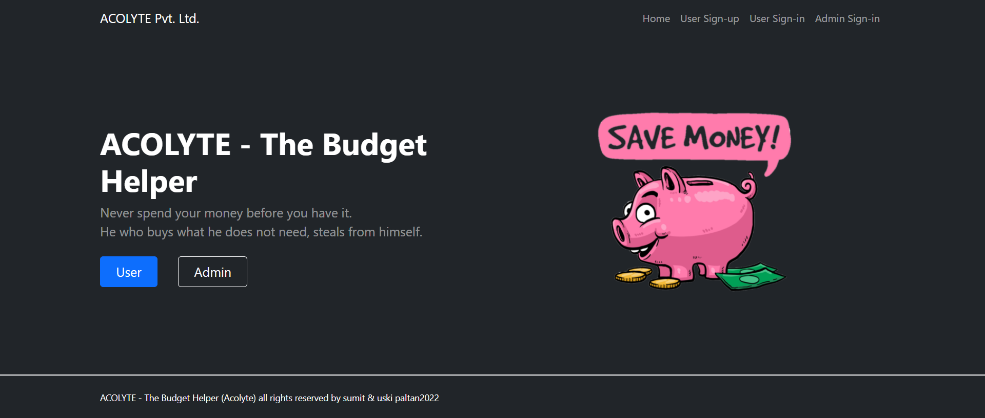
Project Screens -Admin

Slide 12
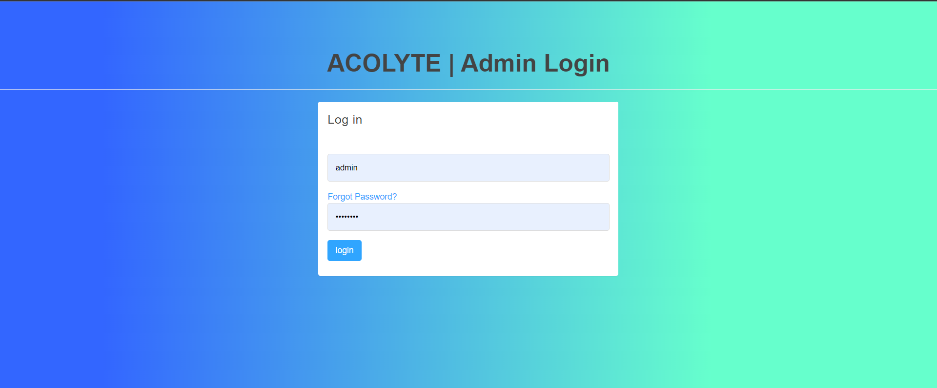

Slide 13
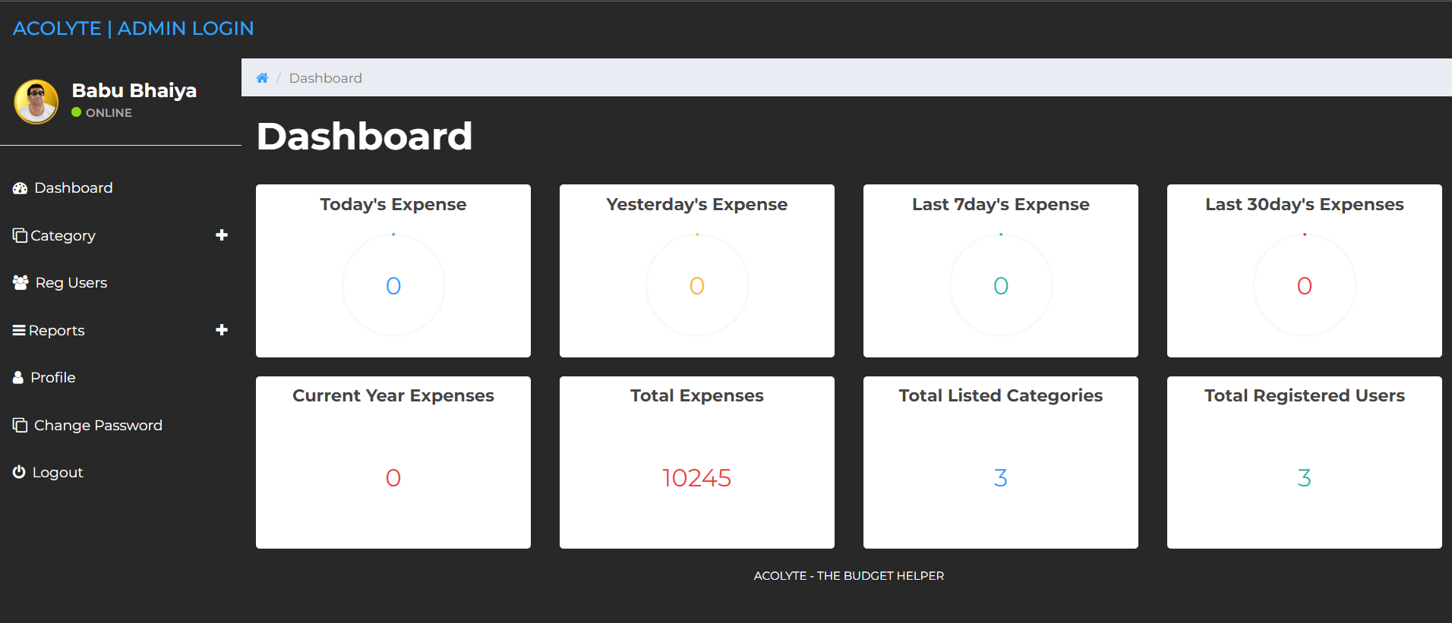

Slide 14
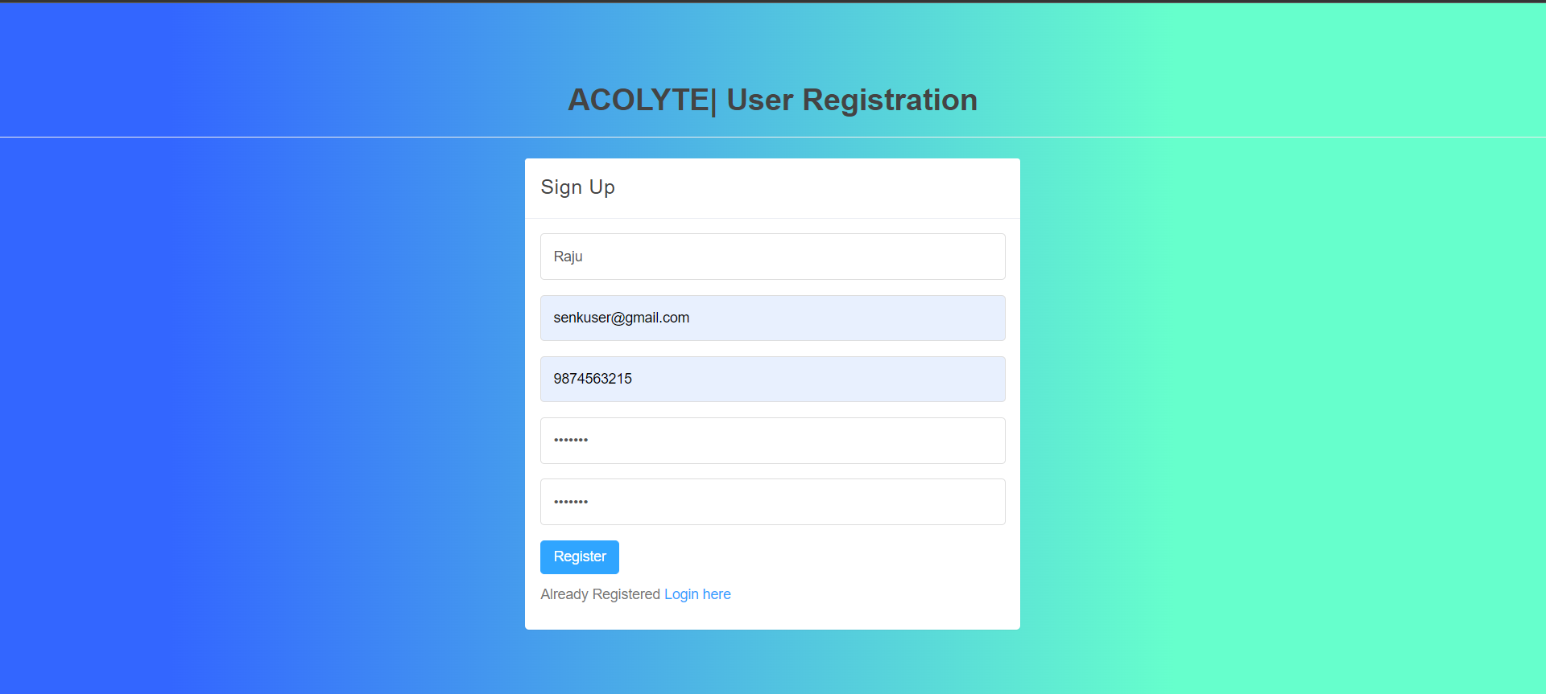
User

Slide 15
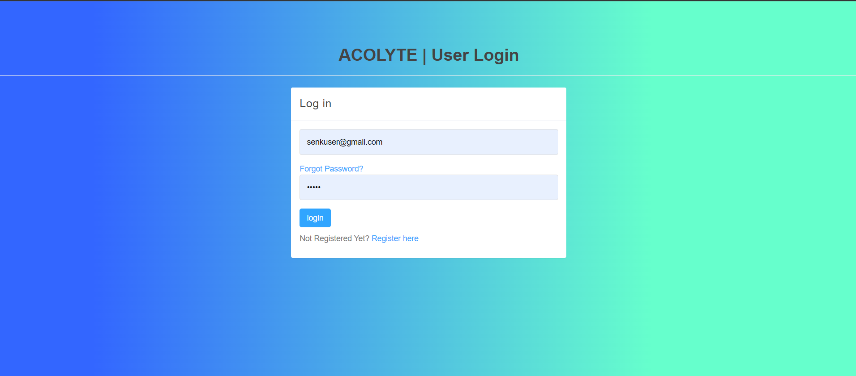

Slide 16
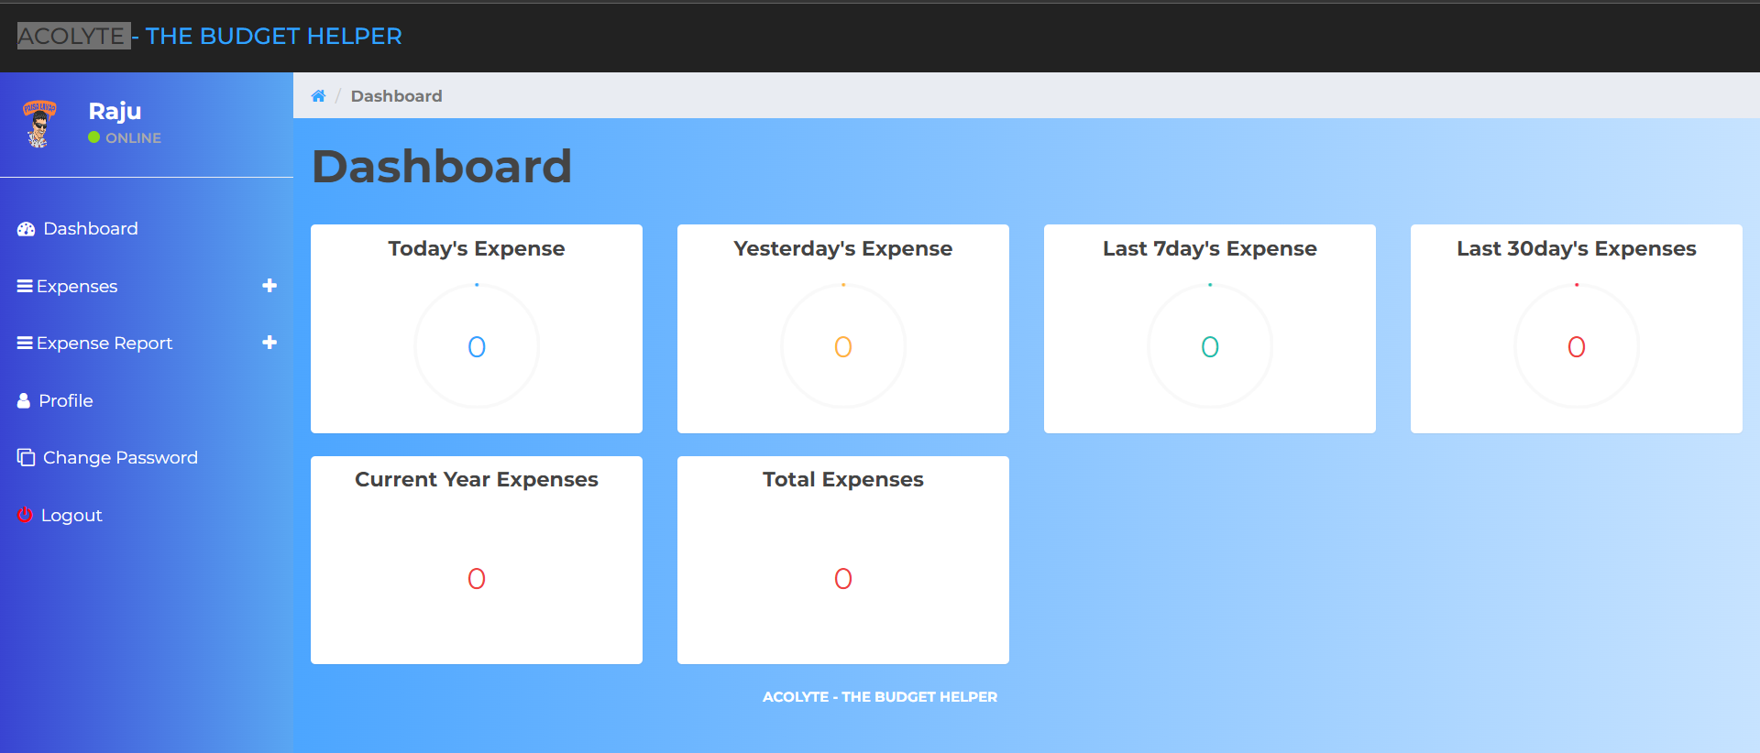

Slide 17
DeDETAILS OF SOFTWARE
MySQL is a popular choice of database
PHP code is embedded into the HTML
XAMPP is a small and light Apache distribution
A

Slide 18
CONCLUSION
The project titled as Acolyte the budget helper was deeply studied and analysed to design the code and implement.
It was done under the guidance of the experienced project guide.
All the current requirements and possibilities have been taken care during the project time.
Acolyte the budget helper is used for maintain the daily expenses.

Slide 19
REFERENCES
For PHP
https://www.w3schools.com/php/default.asp
https://www.sitepoint.com/php/
https://www.php.net/
For MySQL
https://www.mysql.com/
http://www.mysqltutorial.org
For XAMPP
https://www.apachefriends.org/download.html

Slide 20

THANK YOU!!

